Slide 1
Project Prep Course
IT Project Management Consultant, Practice Associate
MBA, PMP, ITILF, CSM, CSPO, CCNA
Current Assignment:
SalesForce
Instructors:
Florence Beckmann
Michael Kropff
Taos Mountain
January 2016
Current Assignment:
VMware
Sr. IT Tech PM Consultant,
Practice Associate
MS Project & Systems Mgmt, PMP, ITILF, CSM, CSPO, CCNA, CCDA

Slide 2
Class focus for next two weeks
Tonight Covering Items Checked – Project Prep will cover
What makes an effective PM
Why do we need a PM – Static Case Study
The 7 Habits of an Effective PM
PM Habits - Dynamic Case Study Overview
Project Team Dynamics - Roles
Project Team Dynamics - Styles
Project Team Dynamics – Organizational Considerations
Start Case Study
How to be an effective PM
What tools does a PM use
Project Constraint Assessment
Timeline Analysis
Ethics & Integrity
Finish Case Study
Personal Dev Bucket List
Focus tonight is: What and Why

Slide 3
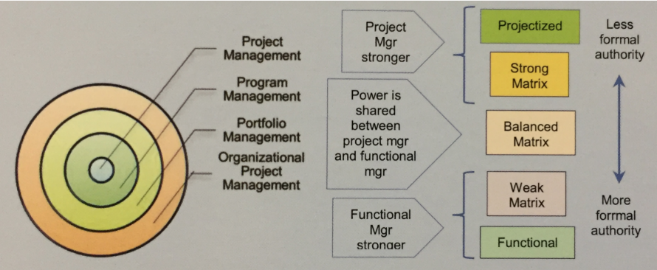
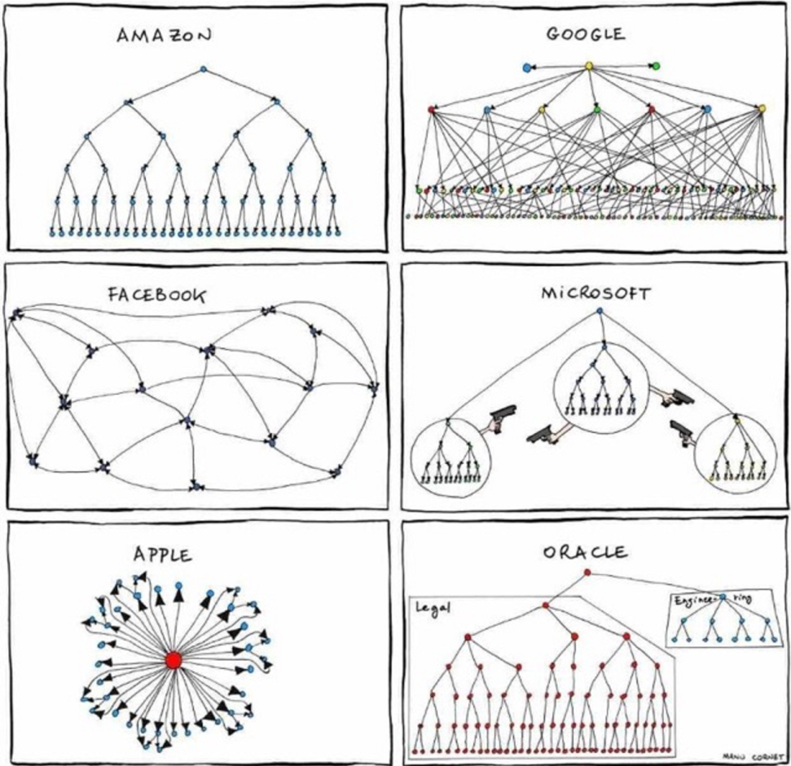
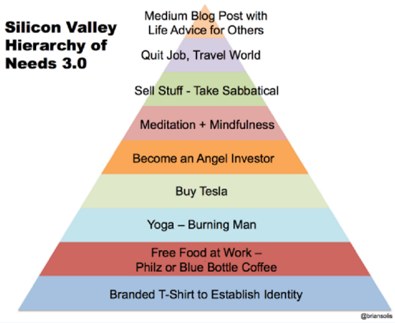
What makes an effective PM?
Project Managers span Role, Style, Cultural & Org boundaries:
Awareness & Flexibility makes a PM successful

Slide 4
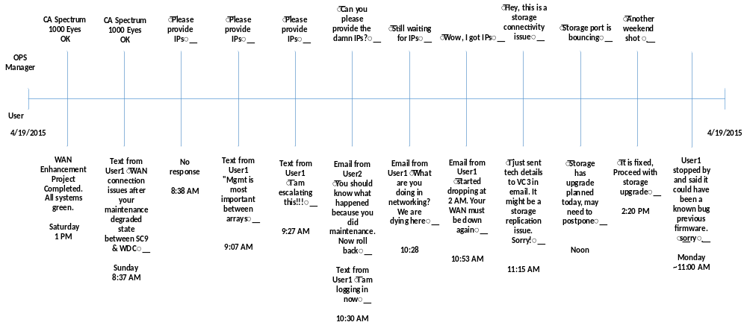
Why do we need PM’s – Static Case Study
What does WAN connection issue mean? Everything is green. Net Ops? Hello???
Who do we call back to work this? Where is Net Ops?
You want me to call everyone? My dash shows WAN OK
Hey, this was nothing to do with WAN. Line card failure.
Escalation occurred before notifying Net Ops?
Network resources sent back home
Who decided this is a WAN event?
This is Net Ops? We just got escalation, we are opening a bridge
Notes:
Mean Time to Restore System
Was 5 hours 53 min
Should have been 3 hours 5 min
What needs to happen:
Net IT Ops will only respond to VC3 on weekends, holidays, and after hours
NetOps must complete troubleshooting checklist and submit to dedicated on-call network engineer before opening a bridge
If NetOps engineer determines severity, NetOps opens bridge as appropriate
Make Troubleshooting Checklist for NetOps
User:
Clear description of the problem
User must furnish ping and traceroute of affected systems end-to-end
User must furnish ping and traceroute of unaffected systems end-to-end
Ping default gateway from both sides to determine layer2/application/localized issue
NetOps :
1000Eyes, CA Spectrum Check
Independent network path validation
Failure on NetOps for not following process
Failure from Network PM for proper handover to NetOps
Failure from SAN PM for baseline checks
Failure from Users for not knowing their services and escalating inappropriately
Initial RCA Findings:
Not hardware issue – no network issues
Firmware bug on storage controller, most likely
Follow up on SFP
Line card under investigation but not likely
Lessons learned:
Net IT Ops will not address issues without VC3 engagement
Net IT Ops needs to provide a troubleshooting punch list
User community must be held accountable
User community is not allowed to contact or commit Net IT Ops resources
CMS engagement process needs review
Eliminate assumption, force user to describe facts of their system

Slide 5
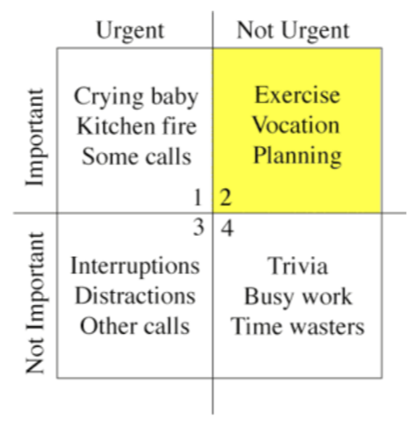
The 7 Habits of an Effective PM (Covey)
Independence (self mastery)
  Be Proactive
  Begin with the End in Mind
  Put First Things First
Interdependence (working with others)
  Think Win-Win
  Seek First to Understand, Then to be Understood
  Synergize
Continuous Improvements (both)
  Sharpen the Saw
Notes:
Quadrant 1: Urgent-Important. These are the most pressing of tasks we’ll likely get to this week. These are the crises that erupt. The most pressing meetings or deadlines fall into this category. When we do fire-fighting, it’s all relating to stuff in this quadrant.
Quadrant 2: Not Urgent – Important. These are the things that matter in the long-term but will yield no tangible benefits this week or even this year. They are things we know we need to get to but probably will push off. It’s having a lunch with an important contact or client. Relationship-building. Some long-term planning. It could be attending a conference to learn about some new area that you’ve heard a little bit about and which sounds promising but might not pan out into anything.
Quadrant 3: Urgent – Not Important. These tasks are the biggest reason we’re not more successful in the long-term. They clog up our time today but, when we look back at these things at the end of the week, we’ll have to admit they were a waste of time. These are interruptions that happen, such as phone calls. These are poorly thought-out meetings that soak up our time, but which we have to attend because we already accepted the invite. These are other activities which we tell ourselves in the moment that we must do but — if we stopped ourselves to really think about — we’d realize they aren’t that important.
Quadrant 4: Not Urgent – Not Important. These things we do because we feel like we’re tired and need a break. It’s watching a mindless TV show at the end of the day. It’s checking and rechecking Facebook and Twitter during the day, because we think we might miss something. It mind be mindlessly eating potato chips, even though we’re not hungry. We prioritize these things in the moment and obviously derive some pleasure from them, but they are really not urgent or important. Yet, we’d be amazed how much time we waste in a given week on these tasks.

Slide 6
Project Team Dynamics - Roles
Roles | Definitions
Project Manager | Responsible for achieving the project objectives
Project Sponsor | Provides financial resources & accountable to enable success
Project Expeditor | Staff assistant and communication coordinator
Project Coordinator | Supports PM in administrative capacity
Product Manager | Investigates, selects, and drives the development of products for an organization, while considering numerous factors such as intended demographic, products offered by the competition, and how well the product fits with the company's business model.
Customer/user | Individuals or org that will receive the projects' product, service, or result
Performing Organization | The enterprise whose employees are involved in doing the project work
Project Team Members | Group performing project work (Dev, QA, IT)
Influencers | People who can influence a project positively or negatively
Stakeholder | The person who is interested, may exert influence, and will be affected by a project
Sponsor | The person paying and empowering the Program/Project
Program Manager | Responsible for managing programs
Portfolio Manager | Responsible for high-level governance of a group of projects or programs and other works
Functional Manager | Owns resources and has human resource responsibilities for them

Slide 7
Project Team Dynamics – Styles / Types
Personal Styles
Supportive: Serves as a repository and plays a consultative role; has a low level of control
Controlling: Provides guidelines, policies, and templates and requires compliances; has a moderate level of control
Directive: Directly involved in managing projects; has a high level of control
Organizational Types
Functional: An org grouped by areas of specialization within different functional areas
Projectized: An org structured by projects
Matrix: A hybrid organization. Strong, balanced, weak
Composite Structure: A combination of functional, projectized, and matrix structures
Project-Based Organization (PBO): Creates a temp framework around projects to achieve strategic goals
Organizational Hierarchy: Operational, middle management, and strategic
PM must adapt to styles and types

Slide 8
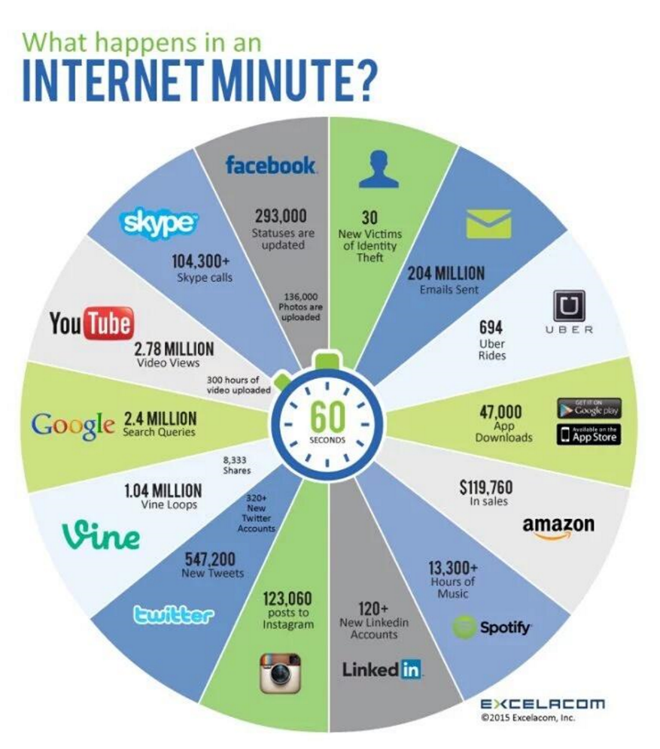
Project Team Dynamics – Considerations
Cultural
Constraints
  Cost
  Schedule
  Scope
  Risk
  Quality
  Resources
  Customer satisfaction
Strategic
Tactical

Slide 9
PM Habits - Dynamic Case Study
Role playing 3 teams, each team has:
  1xProject Manager
  4-5xDevelopers
  1xQA/Tester
  1xProd Manager
Scenario: Develop “Battle of Bravery”
See Program Charter
http://inventwithpython.com/pygame
Discuss Program Charter

Slide 10
Current Network Topology
Internet
Production
Fi
rewall
customers
Vswitch 2
Router 2
Joyhandlers Inc
Development
Vswitch 1
Router 1

Slide 11
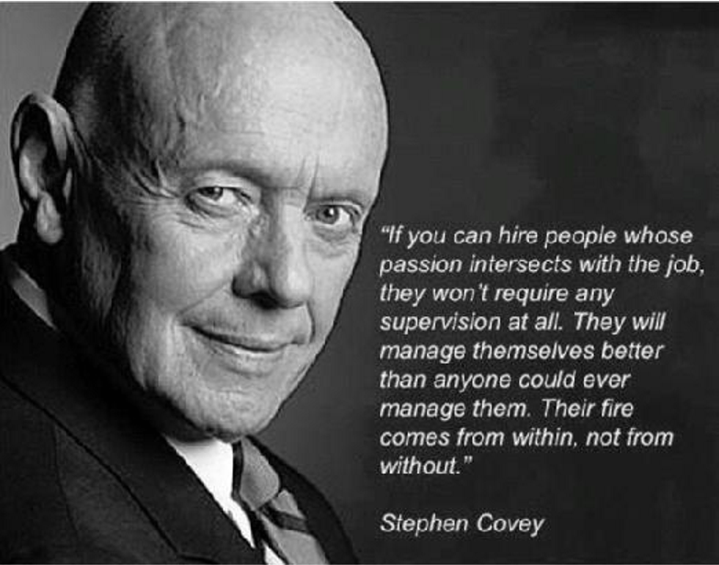
Closing
Questions???

Slide 12
Class focus for Week Two
Tonight Covering Items Checked – Project Prep will cover
What makes an effective PM
Why do we need a PM – Static Case Study
The 7 Habits of an Effective PM
PM Habits - Dynamic Case Study Overview
Project Team Dynamics - Roles
Project Team Dynamics - Styles
Project Team Dynamics – Organizational Considerations
Start Case Study
How to be an effective PM
What tools does a PM use
Project Constraint Assessment
Timeline Analysis
Ethics & Integrity
Finish Case Study
Personal Dev Bucket List
Focus tonight is How

Slide 13
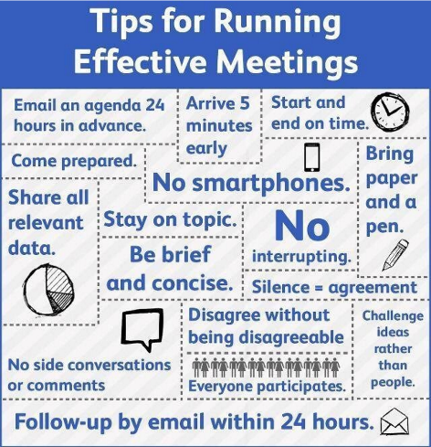
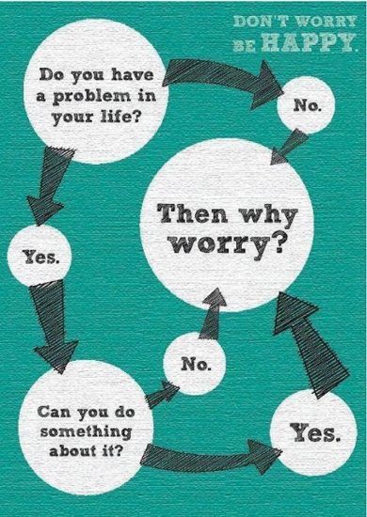
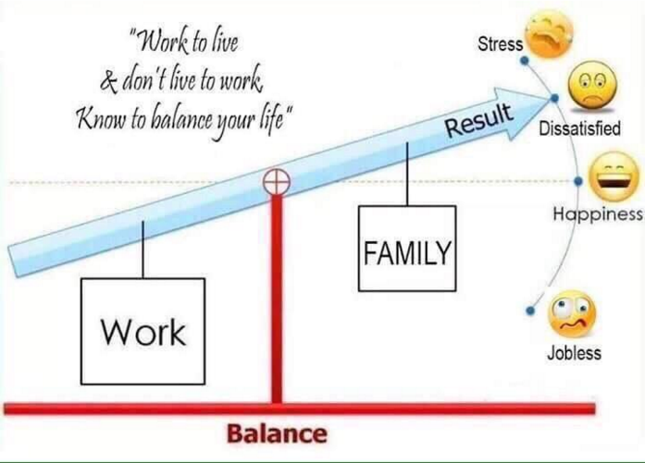
How to be an effective PM
Plan – Do – Check – Act (Think like Batman)
Meetings
  Begin with end-in-mind (Agenda)
  Respect everyone’s time
  No record = wasted meeting
Execution centered on getting commitment (Think Win/Win)
Know your culture Learn from each event (Sharpen the Saw)
Seek Balance (Dependence & Interdependence)
How does being principle centered factor in?

Slide 14
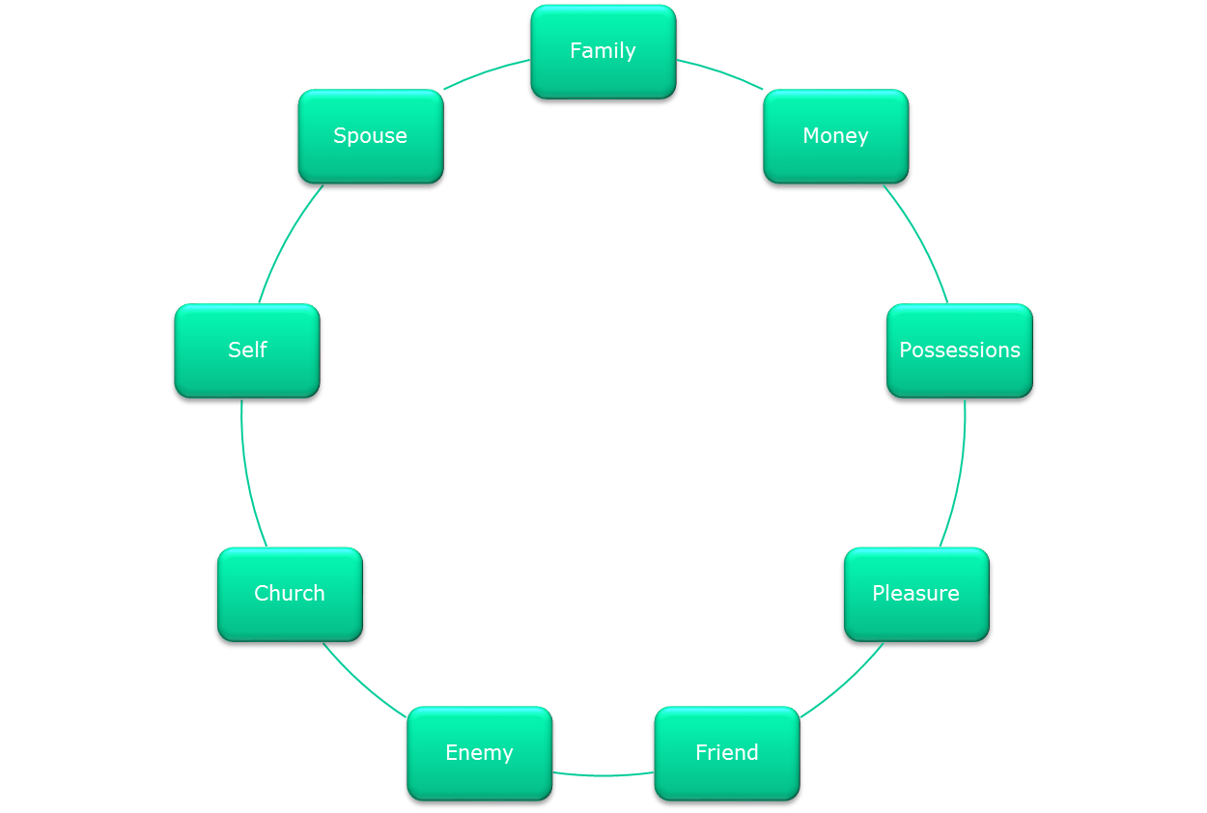
Principle Centered Leadership
Principles

Slide 15
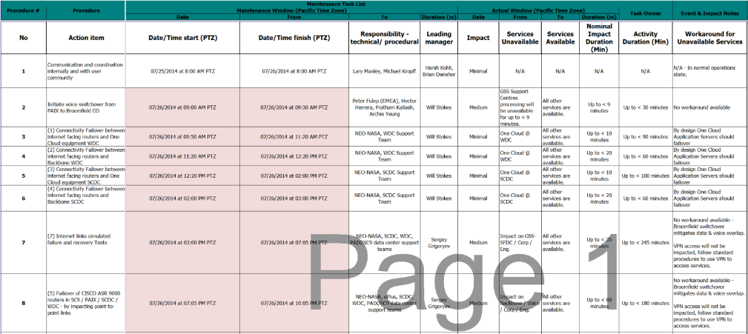
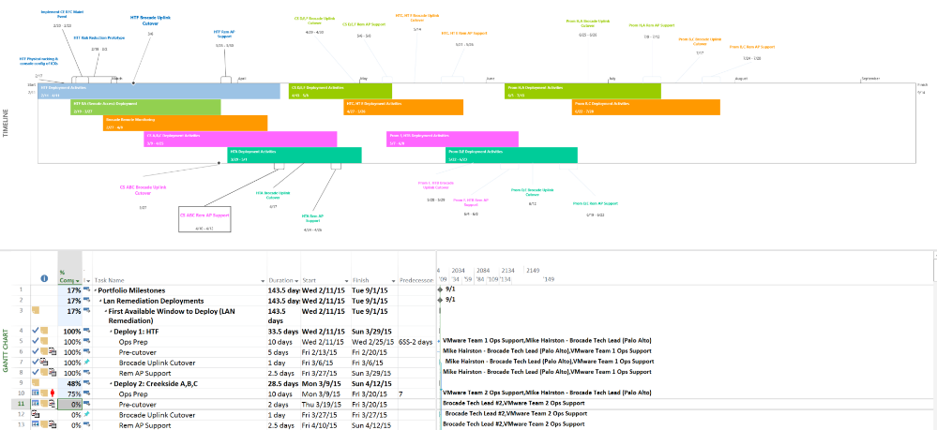
What tools does a PM use
Excel
Project
One Note / Evernote
Jira
Power Point
SalesForce
ServiceNow
PPM
…
Whatever makes sense within the culture!
Tools change, culture matters

Slide 16
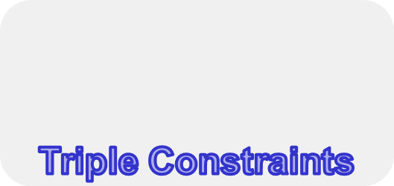
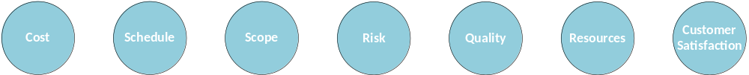
Project Constraint Assessment
  Cost *
  Schedule *
  Scope *
    * - Iron Triangle / Triple Constraints
  Risk
  Quality
  Resources
  Customer satisfaction
Are the triple constraints the most important for PM to focus on?

Slide 17
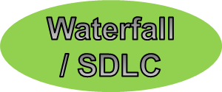
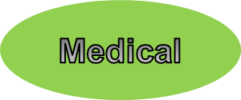
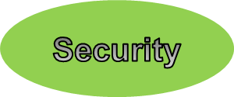
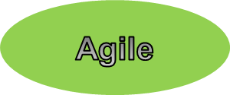

Constraints impact on lifecycle, organization, line of business differs
It depends on what a PM is working on – to focus on only triple constraints can be disastrous!
Primary
Secondary
Constraints impact differently

Slide 18
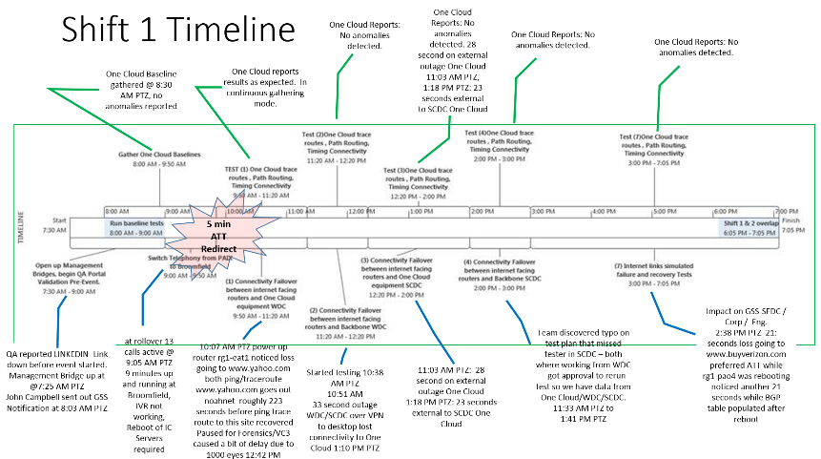
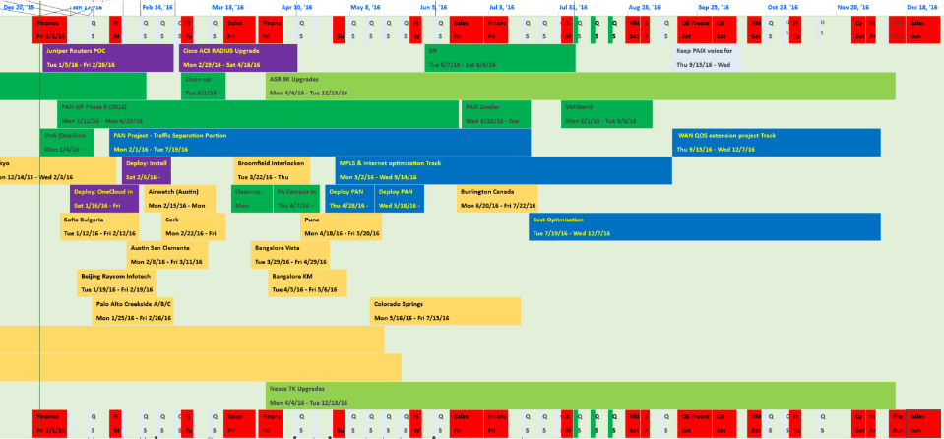
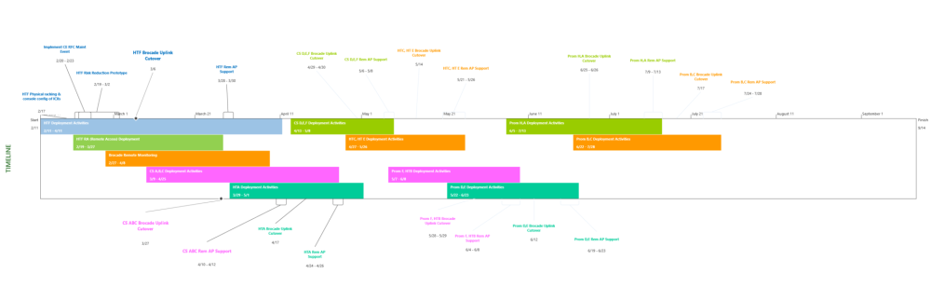
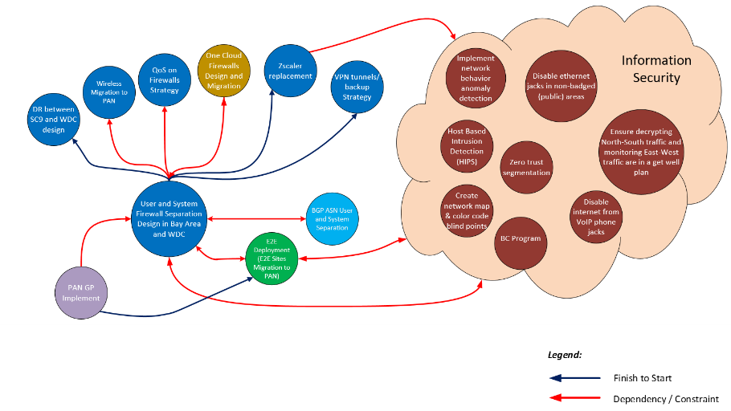
Timeline Analysis
Can be:
Minutes
Hours
Days
Weeks
Identifies:
Who
What
When
Supports:
Project
Program
Portfolio
Useful for
Planning
Execution
Root Cause Analysis

Slide 19
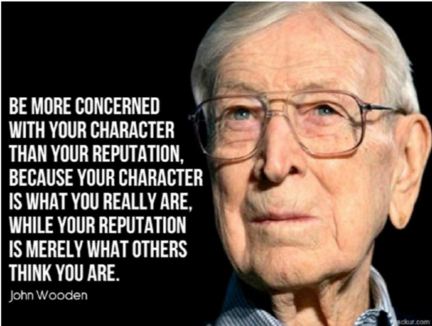
Ethics & Integrity (Being Principle Centered)
Answer: “What should I do?” rather than “What would I do?"
Bribes should be avoided in all circumstances
Always try to resolve a situation directly, quickly, openly, and fairly
  Honesty: Be truthful, provide accurate info in a timely manner, provide accurate and truthful representation to the public, negotiate in good faith; make commitments in good faith, create an environment in which others feel safe to tell the truth, avoid conflict of interest, do not engage in dishonest behavior, do not deceive others, and do not make misleading half-truths or false statements
  Respect: Respect personal, ethnic, and cultural differences, avoid engaging in disrespectful behaviors, listen others' points of view, resolve conflict directly, do not act in an abusive manner, respect property rights
  Fairness: Practice with fairness, strive for a fair solution, ensure transparency, re-examine impartiality. take corrective actions, provide equal access to info to authorized individuals, make opportunities equally available, do not hire or fire, reward or punish based on personal considerations, do not use your position for personal or business gain
  Responsibility: Make decisions based on the best interests of society, accept assignments that are consistent with your background. fulfill commitments, accept accountability, protect proprietary info, and report any illegal conduct

Slide 20
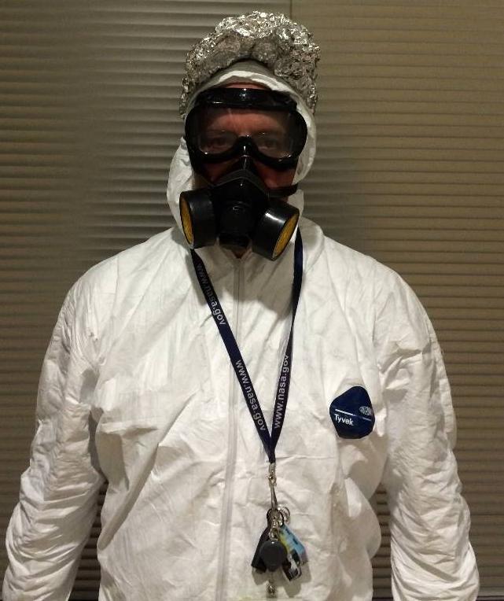
Finish Case Study
Pickup from Last Week
Goal
  Build Project Charter
  Build Initial Project Plan
  Product Sample Demo
Product Samples
  Topologies
  Requirements
  Design
  Scripts (Python)
  Robot Design / Story
  App Story
  Product List
  License Manager Spec
Focus tonight is How

Slide 21
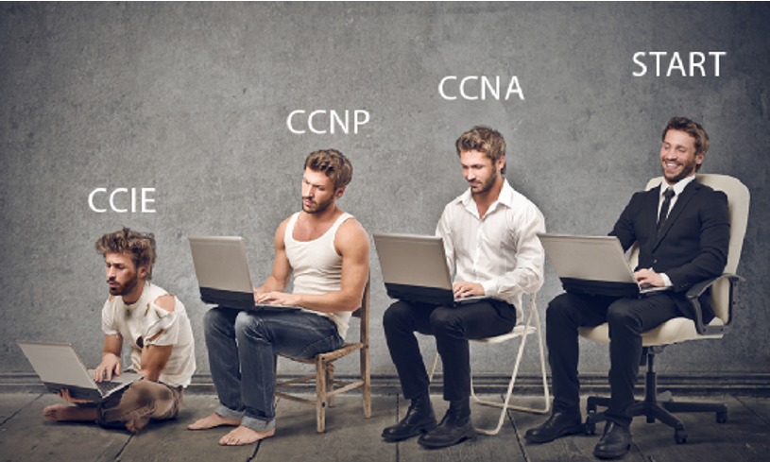
Personal Dev Bucket List
Books:
7 Habits of Highly Effective People by Stephen Covey
How to Win Friends and Influence People by Dale Carnegie
Body Language by various authors
Classes:
Comedy
Acting
Toastmasters
Certifications:
Project + (CompTIA)
CAPM/PMP (PMI)
Games:
Role Playing such as D&D, …
Sharpen the Saw!!!

Slide 22
Conclusion
Questions?
Thank You!!!
See you all next week for your Presentations

Slide 23
Backup

Slide 24
Principle Centered Leadership
Principles

Slide 25
Principle Centered Leadership
Center | Security | Guidance | Wisdom | Power
Friend | Your security is a function of the social mirror. You are highly dependent on the opinions of others. | Your decision-making criterion is "What will they think?" You are easily embarrassed. | You see the world through a social lens. | You are limited by your social comfort zone. Your actions are as fickle as opinion.
Enemy | Your security is volatile, based on the movements of your enemy. You are always wondering what he is up to. You seek self-justification and validation from the like-minded. | You are counter-dependently guided by your enemy's actions. You make your decisions based on what will thwart your enemy. | Your judgment is narrow and distorted. You are defensive, over-reactive, and often paranoid. | The little power you have comes from anger, envy, resentment, and vengeance—negative energy that shrivels and destroys, leaving energy for little else.

Slide 26
Principle Centered Leadership
Center | Security | Guidance | Wisdom | Power
Church | Your security is based on church activity and on the esteem in which you are held by those in authority or influence in the church. You find identity and security in religious labels and comparisons. | You are guided by how others will evaluate your actions in the context of church teachings and expectations. | You see the world in terms of "believers" and "nonbelievers," "belongers" and "non-belongers." | Perceived power comes from your church position or role.
Self | Your security is constantly changing and shifting. | Your judgment criteria are: "If it feels good..." "What I want." "What I need." "What's in it for me?" | You view the world by how decisions, events, or circumstances will affect you. | Your ability to act is limited to your own resources, without the benefits of interdependency.

Slide 27
Principle Centered Leadership
Center | Security | Guidance | Wisdom | Power
Work | You tend to define yourself by your occupational role. You are only comfortable when you are working. | You make your decisions based on the needs and expectations of your work. | You tend to be limited to your work role. You see your work as your life. | Your actions are limited by work role models, occupational opportunities, organizational constraints, your boss's perceptions, and your possible inability at some point in your life to do that particular work.
Possession | Your security is based on your reputation, your social status, or the tangible things you possess. You tend to compare what you have to what others have. | You make your decisions based on what will protect, increase, or better display your possessions. | You see the world in terms of comparative economic and social relationships. | You function within the limits of what you can buy or the social prominence you can achieve.

Slide 28
Principle Centered Leadership
Center | Security | Guidance | Wisdom | Power
Pleasure | You feel secure only when you're on a pleasure "high." Your security is short-lived, anesthetizing, and dependent on your environment. | You make your decisions based on what will give you the most pleasure. | You see the world terms of what's in you. | Your power is almost negligible.
Spouse | Your feelings of security are based on the way your spouse treats you. You are highly vulnerable to the moods and feelings of your spouse. There is deep disappointment resulting in withdrawal or conflict when your spouse disagrees with you or does not meet your expectations. Anything that may impinge on the relationship is perceived as a threat. | Your direction comes from your own needs and wants and from those of your spouse. Your decision-making criterion is limited to what you think is best for your marriage or your mate, or to the preferences and opinions of your spouse. | Your life perspective surrounds things that may positively or negatively influence your spouse or your relationship. | Your power to act is limited by weaknesses in your spouse and in yourself.

Slide 29
Principle Centered Leadership
Center | Security | Guidance | Wisdom | Power
Family | Your security is founded on family acceptance and fulfilling family expectations. Your sense of personal security is as volatile as the family. Your feelings of self-worth are based on the family reputation. | Family scripting is your source of correct attitudes and behaviors. Your decision-making criterion is what is good for the family, or what family members want. | You interpret all of life in terms of your family, creating a partial understanding and family narcissism. | Your actions are limited by family models and traditions.

Slide 30
Principle Centered Leadership
Center | Security | Guidance | Wisdom | Power
Principle | Your security is based on correct principles that do not change, regardless of external conditions or circumstances. You know that true principles can repeatedly be validated in your own life, through your own experiences. As a measurement of self-improvement, correct principles function with exactness, consistency, beauty, and strength. Correct principles help you understand your own development, endowing you with the confidence to learn more, thereby increasing your knowledge and understanding. Your source of security provides you with an immovable, unchanging, unfailing core enabling you to see change as an exciting adventure and opportunity to make significant contributions | You are guided by a compass, which enables you to see where you want to go and how you will get there. You use accurate data, which makes your decisions both implementable and meaningful. You stand apart from life's situations, emotions, and circumstances, and look at the balanced whole. Your decisions and actions reflect both short- and long-term considerations and implications. In every situation, you consciously, proactively determine the best alternative, basing decisions on conscience educated by principles. | Your judgment encompasses a broad spectrum of long-term consequences and reflects a wise balance and quiet assurance. You see things differently and thus you think and act differently from the largely reactive world. You view the world through a fundamental paradigm for effective, provident living. You see the world in terms of what you can do for the world and its people. You adopt a proactive lifestyle, seeking to serve and build others. You interpret all of life's experiences in terms of opportunities for learning and contribution. | Your power is limited only by your understanding and observance of natural law and correct principles and by the natural consequences of the principles themselves. You become a self-aware, knowledgeable, proactive individual, largely unrestricted by the attitudes, behaviors, or actions of others. Your ability to act reaches far beyond your own resources and encourages highly developed levels of interdependency. Your decisions and actions are not driven by your current financial or circumstantial limitations. You experience an interdependent freedom.

